Slide 1
MGMT-6064 PROJECT LEADERSHIP AND MANAGEMENT
Module 12: Project Communication Management (PMBOK)

Slide 2
Objectives
PMBOK processes:
Plan Communications Management (10.1)
Manage Communications (10.2)
Monitor Communications (10.3)
Notes:
Source of material for slides: PMBOK 6e, Chapter 10

Slide 3
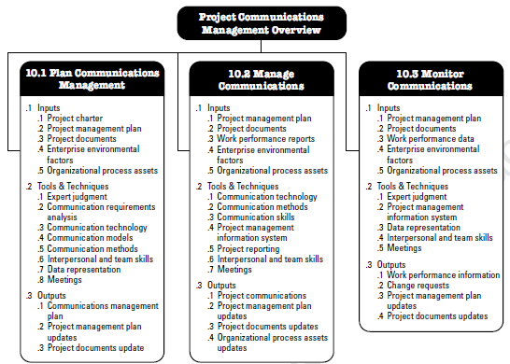
Project communications management Knowledge area
Plan Communications Management (10.1)
Manage Communications (10.2)
Monitor Communications (10.3)
Notes:
Source: PMBOK 6e, p. 360

Slide 4

Project communications management
Different stakeholders will have different interests, cultural backgrounds, knowledge, perspectives – you cannot use the same communication strategy for everyone
Connected with stakeholder management
Three PMBOK processes overlap and interact throughout the project
Develop a communication strategy (plan)
Implement the communication strategy (manage) to ensure information needs are met for each stakeholder (monitor)
Notes:
Image: https://en.unesco.org/youth/toptips/user/pages/images/phases/phase_communication-jumbo.png

Slide 5

Dimensions of communication
Internal vs. external stakeholders
Formal vs. informal communication
Hierarchical (upward, downward, horizontal) vs. non-hierarchical
Official vs. unofficial
Written vs. oral
Verbal vs. non-verbal
Notes:
Image: https://caknowledge.com/wp-content/uploads/2017/05/Difference-Between-Formal-and-Informal-Communication.jpg

Slide 6

Five ‘c’s of written communication
To help reduce misunderstandings….
Correct grammar/ spelling (it’s important!)
Concise expression
Clear purpose and expression directed to the needs of the reader
Coherent logical flow of ideas
Controlling flow of words and ideas (consider graphics or summaries)
C - C - C - C - C
Notes:
Image: https://thumbs.dreamstime.com/z/teacher-pointing-19912479.jpg

Slide 7
PMBOK 10.1 – plan communications management
Developing an approach for project communications, given the needs of each stakeholder group, the needs of the project, and the available organizational assets
How will we get relevant information to stakeholders in a timely manner?
Plan is developed early and modified as needed
This process is part of the Planning process group
Notes:
Source: PMBOK 6e, p. 360

Slide 8

Plan communications management (inputs)
Project Charter: identifies key stakeholders
Project Management Plan: e.g., stakeholder engagement plan (strategies for engaging specific stakeholders)
Project Documents: e.g., stakeholder register
Enterprise Environmental Factors: e.g., organizational culture, stakeholder risk thresholds, geographic location of stakeholders, cultural communication patterns
Organizational Process Assets: e.g., organizational policies about social media or data security, lessons learned from past projects
(Note: Blue text in this slideshow – when studying Inputs/Tools & Techniques/Outputs for our final exam, focus on the blue text on the ITTO slides)
Notes:
Image: https://thumbs.dreamstime.com/z/input-process-output-26459409.jpg
(Note: For PMI’s CAPM/PMP exams, you will have to memorize every ITTO for every process. For this course, focus on the blue text when studying ITTOs.)

Slide 9
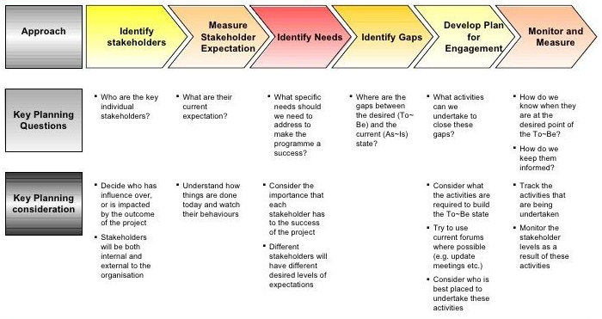
Example of stakeholder engagement plan (outline)
Notes:
Source: https://i.pinimg.com/736x/0b/ea/72/0bea72e03a4e45f7bb008530d22b2f1c--partner-templates.jpg

Slide 10
Plan Communications mgmt (Tools & Techniques)
Expert judgement: people who have knowledge about politics and power in the organization, industry practices, stakeholders, legal requirements for corporate communications, etc.
Communication Requirements Analysis: determine the information needs of each stakeholder (from stakeholder engagement plan), use organizational charts, information needs when communicating externally or internally, etc.
Notes:
Image: https://thumbs.dreamstime.com/z/input-process-output-26459409.jpg

Slide 11
Plan Communications mgmt (Tools & Techniques)
Communications Technology: Tools, systems, equipment used for communication depend on…
Urgency
Availability/reliability of technology
Ease of use
Project environment (e.g., virtual or colocated, time zones, multiple languages)
Sensitivity of information (confidentiality)
Notes:
Image: https://thumbs.dreamstime.com/z/input-process-output-26459409.jpg

Slide 12
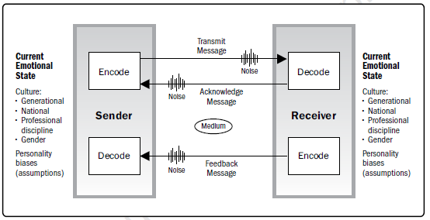
Plan Communications mgmt (Tools & Techniques)
Communication Models: e.g., basic sender/receiver, interactive with feedback (see previous Module)
Notes:
Source: PMBOK 6e: p. 373

Slide 13
Plan Communications mgmt (Tools & Techniques)
Communication Methods:
Interactive vs. Push vs. Pull
Interpersonal vs Small Group vs Public vs Mass vs Social Networking
Choice of methods/artifacts (newsletters, press releases, telephone, presentations, team meetings, focus groups, social media, etc.)
Interpersonal and Team Skills:
Communication Styles Assessments (to identify the preferred communication method/ format/ content)
Political awareness (within the organization)
Cultural awareness (national cultures, organization cultures)
Notes:
Image: https://thumbs.dreamstime.com/z/input-process-output-26459409.jpg

Slide 14
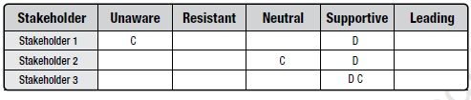
Plan Communications mgmt (Tools & Techniques)
Data Representation: e.g., stakeholder engagement assessment matrix (gaps between current and desired stakeholder engagement levels)
Meetings: virtual or face-to face
Notes:
Source: PMBOK 6e pg. 522
Image: https://thumbs.dreamstime.com/z/input-process-output-26459409.jpg

Slide 15

Plan communications management (outputs)
Communications Management Plan:
Information to be communicated to each stakeholder
Language, format, level of detail, rationale
Escalation process
Frequency and timeframe for distribution, acknowledgement, follow-up (e.g., with flow charts)
Person who will send communications
Person who will receive communications
Handling of confidential information
Resources (time, budget) for communications
Process for updating plan
Communications constraints
Meeting templates
How project or organizational website will be used
(video)
Notes:
Image: https://thumbs.dreamstime.com/z/input-process-output-26459409.jpg
http://wiki.godvillegame.com/images/thumb/9/93/Who_what.jpg/300px-Who_what.jpg

Slide 16
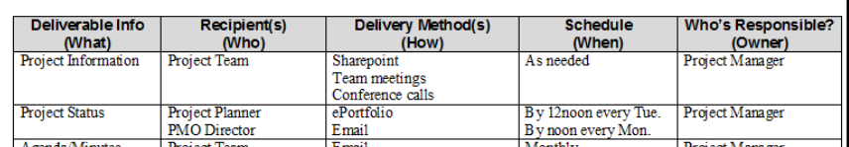
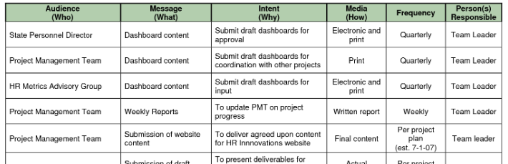
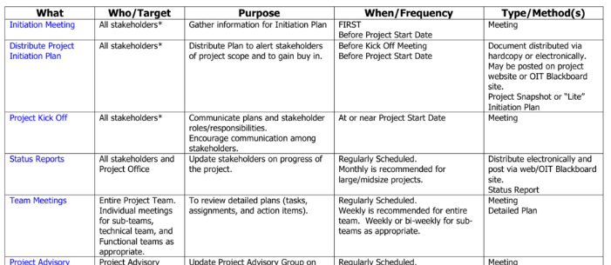
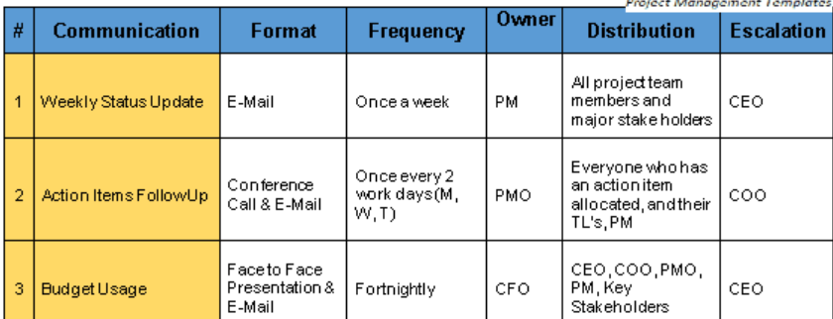
Examples of communication management plans
Notes:
Image: https://thumbs.dreamstime.com/z/input-process-output-26459409.jpg
Plan examples:
https://nationalgriefawarenessday.com/wp-content/uploads/2018/01/project-communication-plan-pcplan.jpg
https://s3.studylib.net/store/data/007572794_2-5437f9c918fe915ea823001455f0d31d.png
http://www.helmettown.com/cdn/1/1995/107/project-communication-plan-template_105128.png
https://4.bp.blogspot.com/-zv4SYpkDwvE/XAoMe5reBNI/AAAAAAAABl8/pexFdhibrYkmTd5gnO24om2oqPXY74SHQCLcBGAs/s640/Communication-Plan-Matrix.png

Slide 17
Plan communications management (outputs)
Project Management Plan Updates: e.g., changes to stakeholder engagement plan
Project Document Updates: e.g., change to stakeholder register
Notes:
Image: https://thumbs.dreamstime.com/z/input-process-output-26459409.jpg

Slide 18
PMBOK 10.2 – Manage communications
Ensuring timely and appropriate collection, creation, distribution, storage, retrieval, management, responses, monitoring, disposition of project communications – it is the process of undertaking communication with stakeholders
Undertaken throughout project
This process is part of the Executing process group
Notes:
Source: PMBOK 6e, p. 360

Slide 19
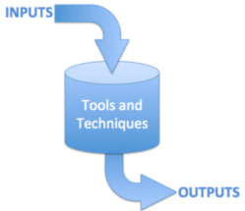
Manage communications - Inputs
Project management plan: e.g., communications management plan, stakeholder engagement plan
Project documents: e.g., issue log, stakeholder register, risk report
Work Performance Reports: e.g., project status dashboards
Enterprise environmental factors: e.g., stakeholder risk thresholds, organizational culture, geographic distribution of resources
Organizational process assets: e.g., lessons learned from past projects, corporate procedures for data security and social media use
Notes:
Image: https://oppmi.com/myoppm/_js/tinymce/jscripts/tiny_mce/plugins/advimage/_js/ImageManager/UserImages/Inputs_Outputs.png

Slide 20
Manage communications – Tools & techniques
Communication Technology: see previous process
Communication Methods: see previous process
Communication Skills: e.g., feedback skills, presentation skills
Project Management Information System (PMIS): e.g., to generate project reports, electronic communications management, social media management
Project Reporting: preparation of project status reports
Interpersonal and Team Skills: e.g., active listening, meeting management, networking, political awareness
Meetings
Notes:
Image: https://oppmi.com/myoppm/_js/tinymce/jscripts/tiny_mce/plugins/advimage/_js/ImageManager/UserImages/Inputs_Outputs.png

Slide 21
Manage communications - outputs
Project Communications: artifacts such as status reports, email messages, etc.
Project Management Plan Updates: e.g., changes to communications management plan
Project Documents Updates: e.g., changes to stakeholder register
Organizational Process Assets Updates: e.g., project records
Notes:
Image: https://oppmi.com/myoppm/_js/tinymce/jscripts/tiny_mce/plugins/advimage/_js/ImageManager/UserImages/Inputs_Outputs.png

Slide 22
PMBOK 10.3 – monitor communications
Ensuring that project and stakeholder information needs are met
Ensuring that information is flowing optimally and has the desired effect
If communications aren’t effective, this might trigger changes to the plan/manage communication processes
This process is part of the Controlling process group
Notes:
Source: PMBOK 6e, p. 360

Slide 23

Monitor communications - Inputs
Project management plan: e.g., stakeholder engagement plan, communication management plan
Project documents: e.g., issue log, project communications
Work performance data: about the types/quantities of communications that have been distributed/communicated
Enterprise environmental factors: e.g., organizational culture, established communication systems, geographic location of resources
Organizational process assets: e.g., corporate policies on social media use or data security, lessons learned
Notes:
Image: http://www.bibleandbusiness.com/wp-content/uploads/2014/02/Input-Output.jpg

Slide 24
Monitor communications – tools & techniques
Expert judgement: people who have knowledge of public relations, communications systems, etc.
Project Management Information System: system for capturing, storing, distributing information to stakeholders
Data Representation: e.g., stakeholder engagement assessment matrix
Interpersonal and Team Skills: e.g., observation/conversation
Meetings: e.g., decision-making meetings
Notes:
http://www.bibleandbusiness.com/wp-content/uploads/2014/02/Input-Output.jpg

Slide 25
Monitor communications- Outputs
Work Performance Information: how planned project communication differs from actual project communications, feedback artifacts, etc.
Change Requests: e.g., new communication procedures
Project Management Plan Updates: e.g., changes to communications management plan
Project Document Updates: e.g., issue log updates, stakeholder register updates
Notes:
http://www.bibleandbusiness.com/wp-content/uploads/2014/02/Input-Output.jpg

